Slide 1

Lecture 7: Helmholtz Wave Equations and Plane Waves
Instructor:
Dr. Gleb V. Tcheslavski
Contact: gleb@ee.lamar.edu
Office Hours: Room 2030
Class web site: www.ee.lamar.edu/gleb/em/Index.htm
“The ninth wave” by Ivan Aivazovsky (1817-1900)

Slide 2
Wave Equation
The propagation of EM energy can be described by a wave equation.
We assume that the media is homogeneous and may have losses. We also assume there are no free charges in the region of interest; therefore, fields are studied outside the “source region”:
ρ_{v} = 0.
Finally, we assume no external currents.
(7.2.1)
Recall that the constitutive relations are:
(7.2.2)
(7.2.3)
(7.2.4)

Slide 3
Wave Equation
For the stated assumptions, the Maxwell’s equations can be rewritten as
(7.3.1)
(7.3.2)
(7.3.3)
(7.3.4)
Equations (7.3.1) and (7.3.2) contain both electric and magnetic field terms; therefore, they are coupled equations. When we change either electric or magnetic field, we automatically affect the other field also.

Slide 4
Wave Equation
Furthermore, the equations (7.3.1) and (7.3.2) are two first-order PDEs in the two dependent variables E and H. We can combine them into a single second-order PDE in terms of one of the variables.
For the E field, we take curl of (7.3.1) and substitute (7.3.2) into RHS of the result…
(7.4.1)
Using the vector identity:
(7.4.2)
We obtain the wave equation:
(7.4.3)

Slide 5
Wave Equation
The equation in (7.4.3) is a general homogeneous 3D vector wave equation. It is valid for cases where there are no external sources.
We also note that the equation itself does not depend on the coordinate system.
Solution of (7.4.3) in general case may be quite complicated… Therefore, we assume that the wave is propagating in free space with no currents and only y component of the electric field exists: i.e. the wave is linearly polarized in the y-direction.
Therefore, in the CCS:
(7.5.1)
Note:
(7.5.2)

Slide 6
Wave Equation
Example 7.1: Show that the wave equation for the magnetic field intensity H can be derived in a similar way as one for the electric field.
By taking curl of the Ampere’s law (7.3.2) and substituting the Faraday’s law (7.3.1) to the result, we arrive at
(7.6.1)
Using the vector identity:
(7.6.2)
We obtain the new wave equation:
(7.6.3)
Note: this wave equation has exactly the same form as one for the electric field.

Slide 7
Wave Equation
Example 7.2: Compute an approximate numerical value for the velocity of light c.
Using the numerical values for the electric and magnetic constants in free space, we write:
Note: the more accurate value for the dielectric constant will slightly reduce this estimate.

Slide 8
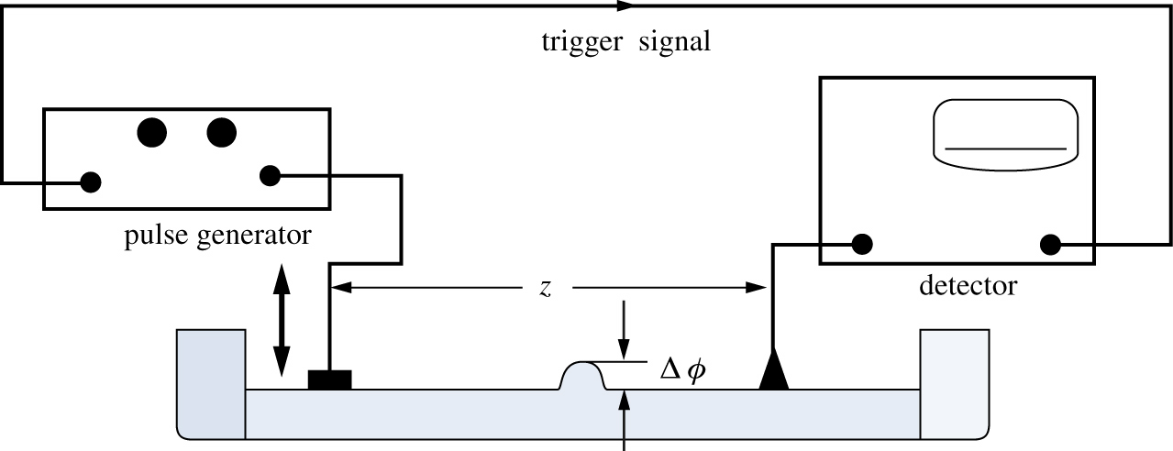
One-dimensional Wave equation
1. Wave experiments in other disciplines (mechanics)
A plunger (wave-maker) in a water tank can move up and down. The repetition frequency of the plunger’s motion is slow enough to excite waves not interfering with each other. The water (mechanical) waves propagate slowly compared to EM.

Slide 9
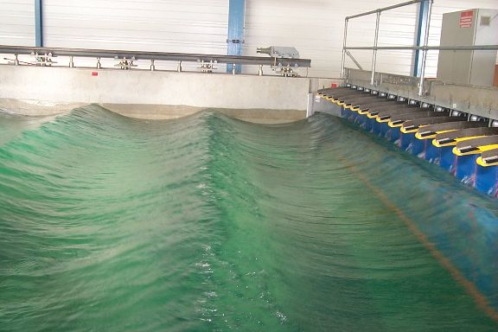
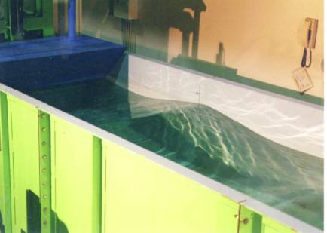
One-dimensional Wave equation
These waves are transversal
We can evaluate the velocity of wave propagation (the speed at which wave crest is traveling) and the trajectory of wave propagation.
Δϕ is perpendicular to the direction of propagation.
The velocity of propagation depends on the surface tension and mass density of water.

Slide 10
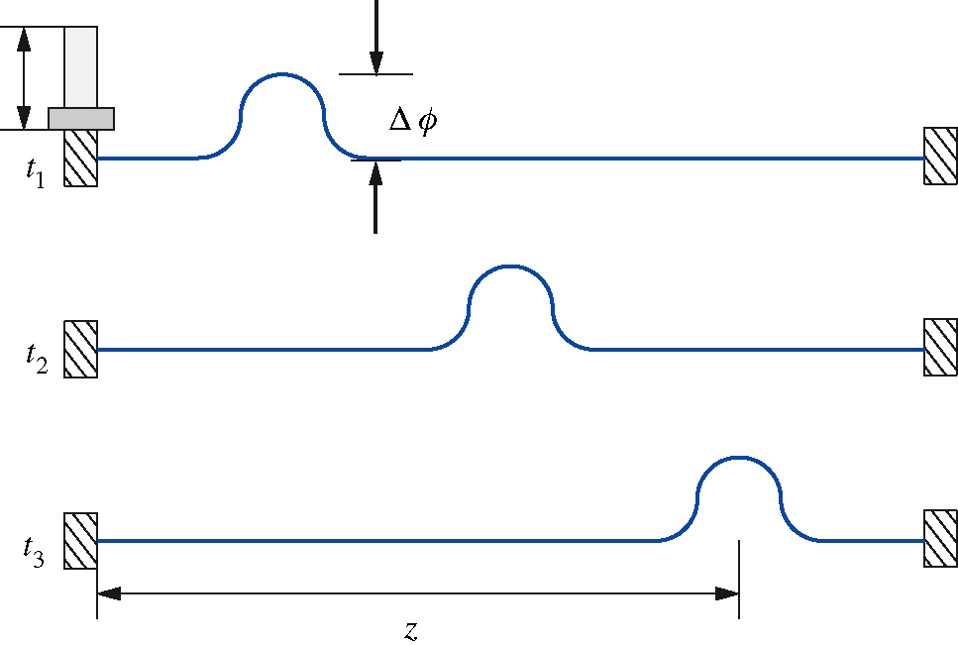
One-dimensional Wave equation
A string is stretched between two points. A small perturbation is launched at one end of it and it propagates to the other end. We neglect any reflections.
The velocity of propagation depends on the tension on the string and its mass density.
These waves are transversal: Δϕ is perpendicular to the direction of propagation

Slide 11
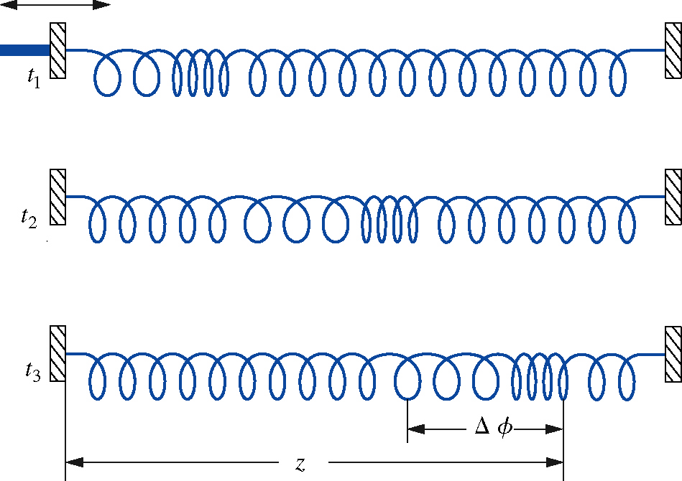
One-dimensional Wave equation
A spring is stretched between two walls. If one of the walls is suddenly moved, a perturbation in the spring compression propagates to the other end of the spring.
We can find the trajectory of the propagation and the velocity of propagation.
The velocity of propagation depends on the elasticity and the mass density of the spring. The wave in this experiment is longitudinal : Δϕ is in the direction of propagation (parallel to it). Longitudinal EM waves do not exist!

Slide 12
One-dimensional Wave equation
2. Analytical solution of a 1D equation – traveling waves.
Recall that in 1D the wave equation is:
(7.12.1)
or
(7.12.2)
The most general solution for this equation is:
(7.12.3)
Here F and G are arbitrary functions determined by the generator exciting the wave.

Slide 13
One-dimensional Wave equation
The solution F(z – ct) is a wave traveling in the +z direction.
The solution G(z + ct) is a wave traveling in the -z direction.
Two possible ways to create both waves simultaneously:
Two generators (sources) at z = -∞ and at z = +∞;
A source at z = -∞ and a reflecting boundary, say, at z = 0:
an incident and a reflected waves!
Let us verify the validity of the general solution…

Slide 14
One-dimensional Wave equation
First, we introduce two new variables:
(7.14.1)
(7.14.2)
And use the chain rule of differentiation:
(7.14.3)
(7.14.4)

Slide 15
One-dimensional Wave equation
The second derivatives are:
(7.15.1)
(7.15.2)
Therefore:
(7.15.3)
Which proves that (7.12.3) is a general form of a solution for (7.12.2).

Slide 16
One-dimensional Wave equation
Let us find a particular solution for the following assumptions:
The solution is a known function P(z) at the time t = 0;
The derivative of the solution is a known function Q(z) at the time t = 0.
(7.16.1)
A particular solution of (7.12.2) that satisfies (7.16.1) is
(7.16.2)
Were is an auxiliary function.

Slide 17
One-dimensional Wave equation
Example 7.3: Show that the function is a solution of the wave equation. That’s a Gaussian-pulse traveling wave.
Let z’ = z – ct; therefore and G(z + ct) = 0. The chain rule:
(7.17.1)
(7.17.2)
(7.17.3)
and
(7.17.4)

Slide 18
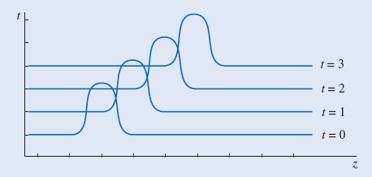
One-dimensional Wave equation
Combining the second derivatives, we arrive at:
(7.18.1)
A sequence of pulses taken at successive times illustrates the propagation of the pulses. The velocity of propagation is c.

Slide 19
One-dimensional Wave equation
We can also define the propagation of Gaussian pulse as an initial value problem:
(7.19.1)
(7.19.2)
(7.19.3)
The auxiliary function will be:
(7.19.4)

Slide 20
One-dimensional Wave equation
Therefore, the particular solution will be:
(7.20.1)
Which is a Gaussian wave traveling in the +z direction.

Slide 21
Matlab solution of a 1D wave eqn.
The main weakness of numerical solutions is that they do not really give any inside to the underlying physics of the problem as theoretical solutions do. However, Matlab allows to plot the numerical solutions, which, to some extend, overcomes this limitation…
Recall that a 1D WE:
(7.21.1)
To develop a numerical solution to (7.21.1), we first need to solve a first-order PDE sometimes called the advection equation:
(7.21.2)
(7.21.2) describes the transport of a conserved scalar quantity in a vector field: for instance, a pollutant spreading through a flowing stream. It’s hard to solve numerically in the general case.

Slide 22
Matlab solution of a 1D wave eqn.
For the initial condition
(7.22.1)
The analytical solution of the advection equation is given by
(7.22.2)
Which is also a solution of the wave equation…
Remark: the wave equation and the advection equation are hyperbolic equations, the diffusion equations are parabolic equations, and Laplace’s and Poisson’s equations are elliptic equations.

Slide 23
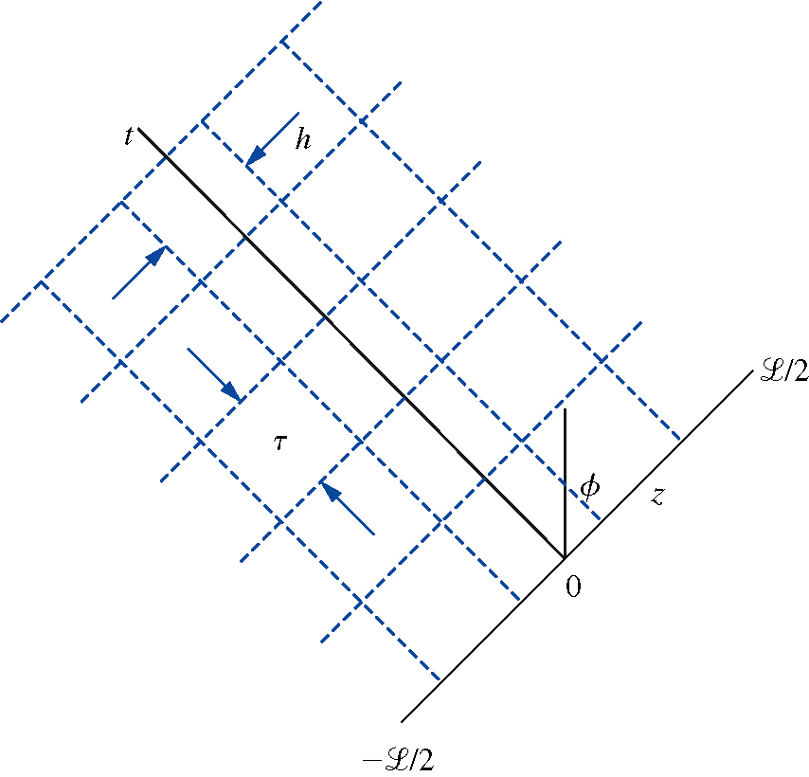
Matlab solution of a 1D wave eqn.
We assume that the space z and time t can be represented in a 3D figure. The amplitude φ of the wave is specified by the third coordinate.
Next, we set up a numerical grid: we divide the region L, in which the wave propagates, into N sections (N = 4 in the figure).
Therefore, the step in space:
(7.23.1)
Assuming that the velocity of the propagation is c and it takes time τ for the wave to cover h:
(7.23.2)

Slide 24
Matlab solution of a 1D wave eqn.
We assume the solution to be stable and use the periodic boundary conditions: once a numerically calculated wave reaches the boundary at z = +L/2, it reappears at the same time at the boundary z = -L/2 and continues to propagate in the region –L/2 ≤ z ≤ +L/2. However, instead of evaluating the wave at the edges, it is estimated at ½ of a spatial increment from them.
Using the forward difference method:
(7.24.1)
where
(7.24.2)
(7.24.3)

Slide 25
Matlab solution of a 1D wave eqn.
Using the central difference method:
(7.25.1)
Therefore, the advection equation will be:
(7.25.2)
In (7.25.2), all terms except for one are given for the present time, and one term specifies the future value of the wave:
(7.25.3)
That’s a Finite Difference Time Domain (FDTD) method.

Slide 26
Matlab solution of a 1D wave eqn.
The expression in (7.25.3) is valid in the interior range: 2 ≤ n ≤ N-1. At the edges employing the periodic boundary conditions:
(7.26.1)
(7.26.2)
For unstable problems, the Lax method is used:
(7.26.3)
(7.26.4)
(7.26.5)

Slide 27
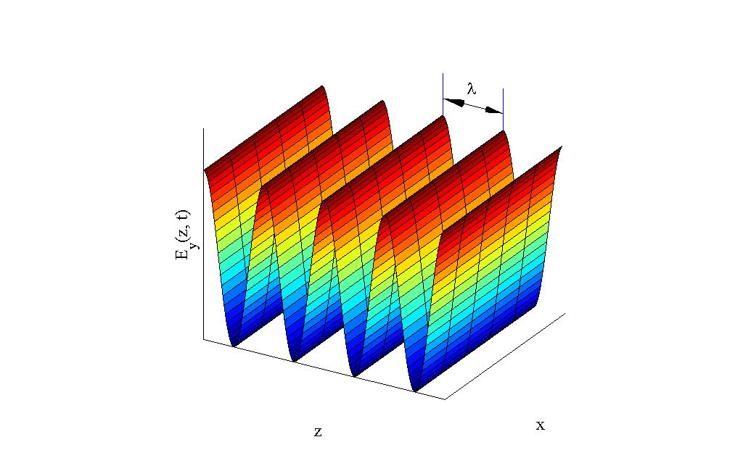
Time-harmonic plane waves
1. Plane waves in vacuum.
Assuming that a time-harmonic propagating wave is polarized in the y-direction.
(7.27.1)
a phasor
In a vacuum, the phase velocity of the wave equals to the velocity of light c.
Therefore, the 1D wave equation is:
(7.27.2)

Slide 28
Time-harmonic plane waves
or
(7.28.1)
We introduce a new quantity called a wave number:
(7.28.2)
Therefore, the 1D wave equation (the Helmholtz equation) is:
(7.28.3)

Slide 29
Time-harmonic plane waves
A solution of the second-order ODE (7.28.3) is in a form:
(7.29.1)
where a and b are the integration constants. Incorporating (7.27.1), we obtain:
(7.29.2)
The real part of the solution will be:
(7.29.3)
Note: instead of the real, we could use the imaginary part – sin function.
The first term in (7.29.3) is a wave moving in a +z direction; the second term is a wave moving in the –z direction (incident and reflected waves).

Slide 30
Time-harmonic plane waves
Since the waves are propagating in vacuum, the phase velocities for these traveling waves are:
(7.30.1)
In general, the phase velocity is a vector since it has both a magnitude and a direction. It can have a value greater than the light speed! However, there is no energy (or particles) transferred at that speed.
The wave number may also be a vector and, therefore, indicate the direction, in which the wave is traveling. In this case, it is frequently called a wave vector and the quantity kz can be replaced by
(7.30.2)

Slide 31
Time-harmonic plane waves
Example 7.4: A polarized in the y direction electric field that propagates in vacuum was simultaneously measured at z = 0 and one wavelength away at z = 2 cm. The amplitude is 2 μV/m. Find the frequency of excitation, and write an expression that describes the wave if it’s moving in the +z direction.
The wavelength is λ = 0.02 m, therefore:
(7.31.1)
The wave number:
(7.31.2)
The wave is:
(7.31.3)

Slide 32
Time-harmonic plane waves
Example 7.5: Show that a linearly polarized plane wave can be resolved into two equal amplitude circularly polarized waves: i.e. waves that rotate about the z axis.
The linearly polarized wave
(7.32.1)
can be written as a sum of two components:
(7.32.2)
where
(7.32.3)
Since
(7.32.4)
We obtain:
(7.32.5)
Which demonstrates that the first and second waves rotate in opposite directions.

Slide 33
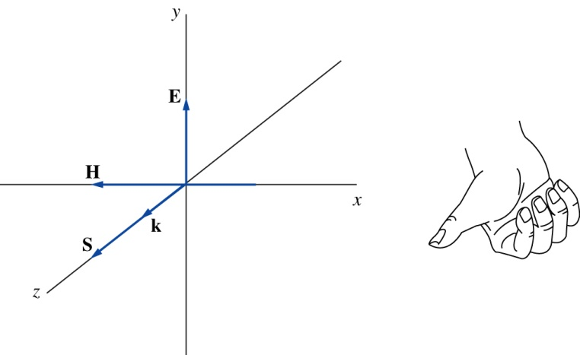
Time-harmonic plane waves
2. Magnetic field intensity and characteristic impedance.
The magnetic field intensity can be found via the Faraday’s law:
(7.33.1)
Since:
(7.33.2)
Therefore:
(7.33.3)

Slide 34
Time-harmonic plane waves
We introduce a new quantity called a characteristic impedance of the medium:
(7.34.1)
For a free space:
(7.34.2)
Therefore:
(7.34.3)
The Poynting vector:
(7.34.4)
If we know the value of one of the field components and the characteristic impedance, we can find the value of the other field component.

Slide 35
Time-harmonic plane waves
Example 7.6: Find the magnetic field intensity for the following electric field in vacuum:
This direction of the magnetic field intensity is required so the power will flow in the +z direction:
?

Slide 36
Time-harmonic plane waves
Example 7.7: Find the average power in a circular area in a plane defined by z = constant, whose radius is 3 m if the electric field in a vacuum is:
In a complex form:
Since the field is in a vacuum, Z₀ = 120 π.
The average power:

Slide 37
Plane wave propagation in a dielectric medium
1. Plane wave in a lossless homogeneous dielectric.
The wave number for the wave propagating in a vacuum is a function of permittivity and permeability of free space:
(7.37.1)
Naturally, for a dielectric medium that may have different constants, the wave number will be
(7.37.2)

Slide 38
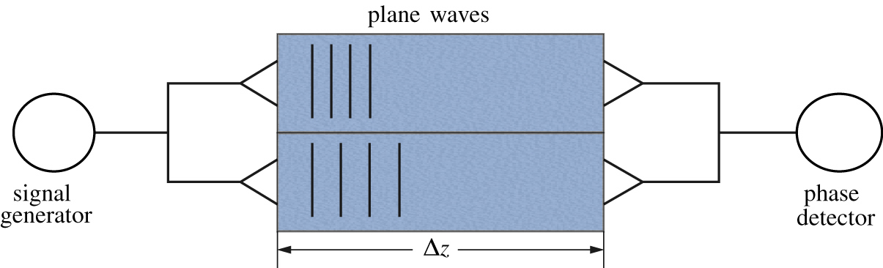
Plane wave propagation in a dielectric medium
If a plane wave generated by a signal generator propagates through two different dielectrics…
Say, with the same magnetic constants but different permittivities, the wave numbers will be for these two media:
(7.38.1)
Both signals travel the same distance Δz but will have different phase velocities:
(7.38.2)

Slide 39
Plane wave propagation in a dielectric medium
This difference in velocities delays the arrival of one signal with respect to the other and causes a phase difference that can be detected:
(7.39.1)
If the total phase change in the signal passing through one of the paths is known:
(7.39.2)
The relative phase difference is
(7.39.3)
Therefore, if the properties of one of the regions are known and the phase difference is measured, we can identify the other material.

Slide 40
Plane wave propagation in a dielectric medium
The ratio of the phase velocity in a vacuum to the phase velocity in a dielectric is called the index of refraction for the material:
(7.40.1)
Optical materials are usually characterized by their index of refraction.
Material | Index | Material | Index
Vacuum | 1.00000 | Spectacle crown, C-1 | 1.523
Air at STP | 1.00029 | Sodium chloride | 1.54
Ice | 1.31 | Polystyrene | 1.55-1.59
Water at 20 C | 1.33 | Carbon disulfide | 1.63
Acetone | 1.36 | Flint glasses | 1.57-1.75
Ethyl alcohol | 1.36 | Heavy flint glass | 1.65
Sugar solution(30%) | 1.38 | Extra dense flint, EDF-3 | 1.7200
Fluorite | 1.433 | Methylene iodide | 1.74
Fused quartz | 1.46 | Sapphire | 1.77
Glycerine | 1.473 | Rare earth flint | 1.7-1.84
Sugar solution (80%) | 1.49 | Lanthanum flint | 1.82-1.98
Typical crown glass | 1.52 | Arsenic trisulfide glass | 2.04
Crown glasses | 1.52-1.62 | Diamond | 2.417

Slide 41
Plane wave propagation in a dielectric medium
Example 7.7: Find the phase difference if one region is filled with a gas with ε_{r} = 1.0005 and the other region is a vacuum. The frequency of oscillation is 10 GHz and the length is Δz = 1m.
The phase difference is
This difference is small but can be detected. Also, if the travel distance is increased, the resolution (i.e. detectable phase difference) will be higher.

Slide 42
Plane wave propagation in a dielectric medium
2. Plane wave in a lossy homogeneous dielectric.
A dielectric material can be lossy, i.e. exhibit a nonzero conductivity σ. In this situation, a conduction current must be added to the displacement current when considering the Ampere’s law.
(7.42.1)
(7.42.2)
Assuming, as before, no free charges (ρ_{v} = 0) and following the same procedure:
(7.42.3)

Slide 43
Plane wave propagation in a dielectric medium
Assuming, as previously, that the electric field is linearly polarized in the y direction and the wave propagates in the z direction, we arrive to:
(7.43.1)
or
(7.43.2)
Where the propagation constant:
(7.43.3)

Slide 44
Plane wave propagation in a dielectric medium
The propagation constant is complex:
(7.44.1)
In a vacuum, α = 0 and β = k. In a general case, the real and imaginary parts are nonlinear functions of the frequency:
(7.44.2)
(7.44.3)

Slide 45
Plane wave propagation in a dielectric medium
As a result, the phase velocity may depend on the wave’s frequency. This phenomena is called dispersion and the medium in which wave is propagating, is called a dispersive medium (every lossy medium).
(7.45.1)
Another quantity we recall here is the group velocity:
(7.45.2)

Slide 46
Plane wave propagation in a dielectric medium
The component of the electric field propagating in the +z direction is:
(7.46.1)
Wave propagates with a phase constant β but the amplitude decreases with an attenuation constant α.
Units of β are radians/m.
Units of α are nepers/m [Np/m]. If α = 1 Np/m, the amplitude of the wave will decrease e times at a distance 1 m. 1 Np/m ≅ 8.686 dB/m.
The characteristic impedance is:
(7.46.2)

Slide 47
Plane wave propagation in a dielectric medium
Example 7.8: A 10 V/m wave at the frequency 300 MHz propagates in the +z direction in an infinite medium. The electric field is polarized in the x direction. The parameters of medium are ε_{r} = 9, μ_{r} = 1, and σ = 10 S/m. Write the complete time domain expression for the electric field.
We can find the attenuation constant as
The phase constant is:

Slide 48
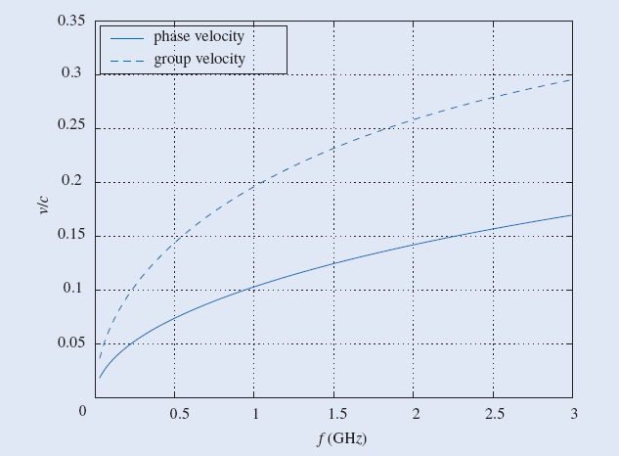
Plane wave propagation in a dielectric medium
The complex propagation constant is γ ≅ 108 + j110 and the electric field is
Example 7.9: Plot the phase velocity and the group velocity for the medium with ε_{r} = 9, μ_{r} = 1, and σ = 10 S/m
The velocities can be described by (7.45.1) and (7.45.2).
Both velocities increase with the frequency. The limit is the same:

Slide 49
Plane wave propagation in a dielectric medium
Two approximations are frequently used:
A) A dielectric with small losses (σ << ωε) with a high-frequency approximation:
(7.49.1)
The approximate values for attenuation and propagation constants are:
(7.49.2)
(7.49.3)

Slide 50
Plane wave propagation in a dielectric medium
(7.50.1)
In this situation, the phase and the group velocities are the same. Also, some attenuation is introduced.
“A pizza in a microwave oven”: water in the pizza acts as a conductor turning pizza into a complex impedance. The wave passing through it decays, therefore, the energy is absorbed and must be converted into heat.
B) A dielectric with large losses (σ >> ωε) with a low-frequency approximation:
The conduction current is much greater than the displacement current, therefore:
(7.50.2)

Slide 51
Plane wave propagation in a dielectric medium
In this situation:
(7.51.1)
Therefore:
(7.51.2)
We introduce a skin depth of the material:
(7.51.3)
The skin depth decreases with the increasing frequency – skin effect.

Slide 52
Plane wave propagation in a dielectric medium
Example 7.10: Estimate the skin depth of copper at a frequency of 3 GHz. The conductivity of copper is σ = 5.8 ⋅ 10⁷ S/m; ε_{r} = 1, and μ_{r} = 1.
Plot the magnitude of the electric field of a plane wave for t = 0 and E_{y0} = 10 V/m.
Check the validity of the low-frequency approximation first:
We can use the approximation.

Slide 53
Plane wave propagation in a dielectric medium
Imagine: if the “pizza in a microwave oven” was covered by a good conductor… The skin effect would lead to all energy being absorbed by a tiny layer of the conductor and the pizza would be cold.
Finally, the characteristic impedance for an imperfect conductor is:
(7.53.1)
If the conductivity is large, Z approaches zero.
??QUESTIONS??

Slide 54
Polarization
Polarization is the property of electromagnetic waves, such as light, that describes the direction of the transverse electric field. More generally, the polarization of a transverse wave describes the direction of oscillation in the plane perpendicular to the direction of travel. Longitudinal waves such as sound waves do not exhibit polarization, because for these waves the direction of oscillation is along the direction of travel.

Slide 55
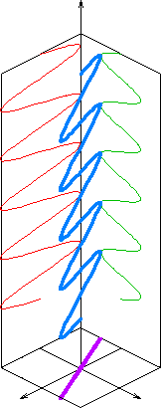
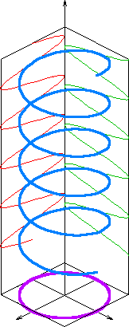
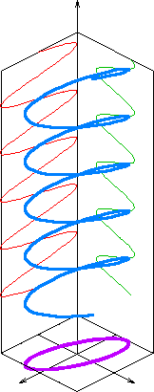
Polarization types
Linear Circular Elliptical

Slide 56
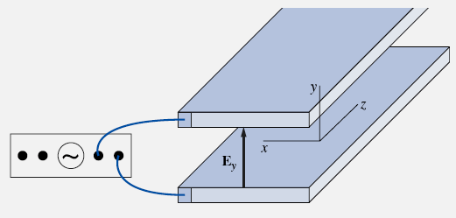
Linear polarization
In such arrangement with two parallel infinite plates, when applying a sinusoidal input to the system, the phase difference between voltages on the top and bottom plates will be 180⁰.
The resulting electric field between the plates appears to have only one non-zero component and, therefore, said to be linearly polarized in the u_{y} direction.
Back

Slide 57
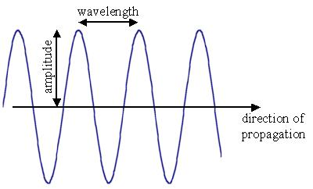
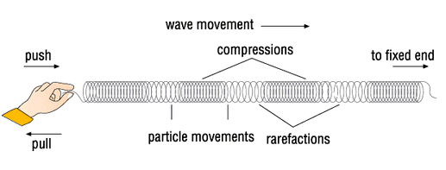
Types of waves
A transverse EM wave is a wave whose E and H vectors are perpendicular to the direction of wave’s propagation: light, radio-waves.
A longitudinal EM wave would be a wave whose E and H vectors are parallel to the direction of wave’s propagation: sound.

Slide 58

Types of transversal waves
A plane wave is a constant-frequency wave whose wavefronts (surfaces of constant phase) are infinite parallel planes of constant amplitude normal to the phase velocity vector.
By extension, the term is also used to describe waves that are approximately plane waves in a localized region of space. For example, a localized source such as an antenna produces a field that is approximately a plane wave in its far-field region.
A wavefront

Slide 59
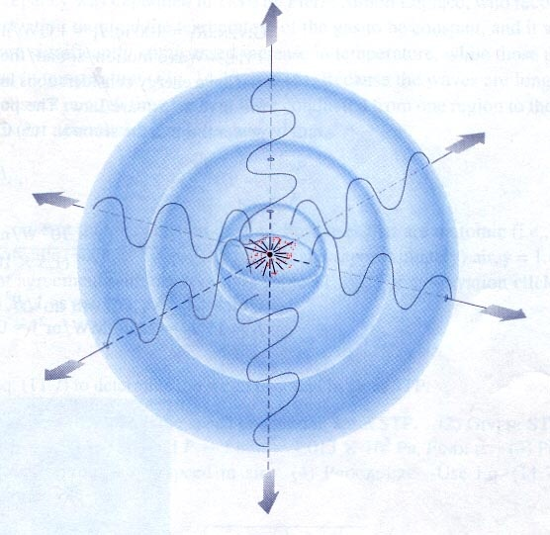
Types of transversal waves
A spherical wave is a constant-frequency wave whose wavefronts (surfaces of constant phase) are parallel concentric spheres of constant amplitude normal to the phase velocity vector.
When the distance from the source is very large, a spherical wave can be locally approximated as a plane wave.
Back

Slide 60
Phase and group velocities
The phase velocity of a wave is the rate at which the phase of the wave propagates in space. This is the velocity at which the phase of any single frequency component of the wave will propagate. We can pick one particular phase of the wave (for example the crest) and it would appear to travel at the phase velocity.
Here, ω is a radial frequency and k is the wave number.
The group velocity of a wave is the velocity with which the variations in the shape of the wave's amplitude (modulation or envelope of the wave) propagate through space.

Slide 61
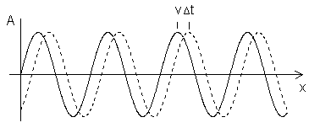
Phase and group velocities
In the simple case of a pure traveling sinusoidal wave we can imagine a "rigid" profile being physically moved in the positive x direction with speed v.
Clearly, the wave function depends on both time and position. At any fixed instant of time, the function varies sinusoidally along x, whereas at any fixed location on the x axis the function varies sinusoidally with time. If the wave profile is a solid entity sliding to the right, then obviously the phase velocity is the ordinary speed with which the actual physical parts are moving. However, we could also imagine the “magnitude" as the position along a transverse space axis, and a sequence of tiny massive particles along the x axis, each oscillating vertically. In this case the wave pattern propagates to the right with phase velocity v_{p}, just as before, and yet no material particle has any motion at all. This illustrates that the phase of a traveling wave may or may not correspond to a particular physical entity.
Back

